Slide 1


Python Working with Feature Data
Ghislain Prince
Jibin Liu
2018 Esri DEVSummit Conference | Palm Springs, CA

Slide 2
Python: Working with Feature Data
Join us as we discuss working with feature data in ArcGIS using ArcPy and the data access module (arcpy.da). Highlights and demonstrations will include getting the best performance out of cursors, editing data, working with NumPy arrays and 3rd party libraries to extend analysis, and managing geodata.

Slide 3
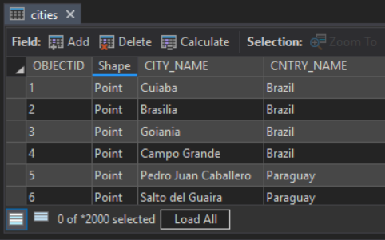

Slide 4
Cursors
Cursors provide record-by-record, feature-by-feature access
Basic necessity for many workflows
Two implementations
arcpy.da cursors and “Classic” cursors
Which one? Unless you have legacy code you don’t want to update, use arcpy.da
SearchCursor | Read-only access
UpdateCursor | Update or delete rows
InsertCursor | Insert rows

Slide 5
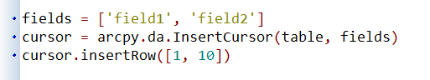
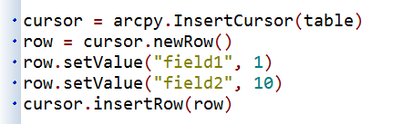
Cursors
arcpy.da cursors use lists and tuples
Row values are accessed by index
“Classic” cursors
For scripts written befor 10.1
Use Row objects
Row values are handled using setValue, getValue properties

Slide 6
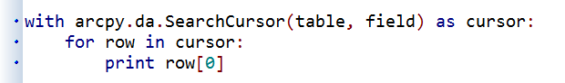
with statements
arcpy.da Cursors support with statements
with statements
In Python, with statements provide context management
Locks *
Code clarity

Slide 7
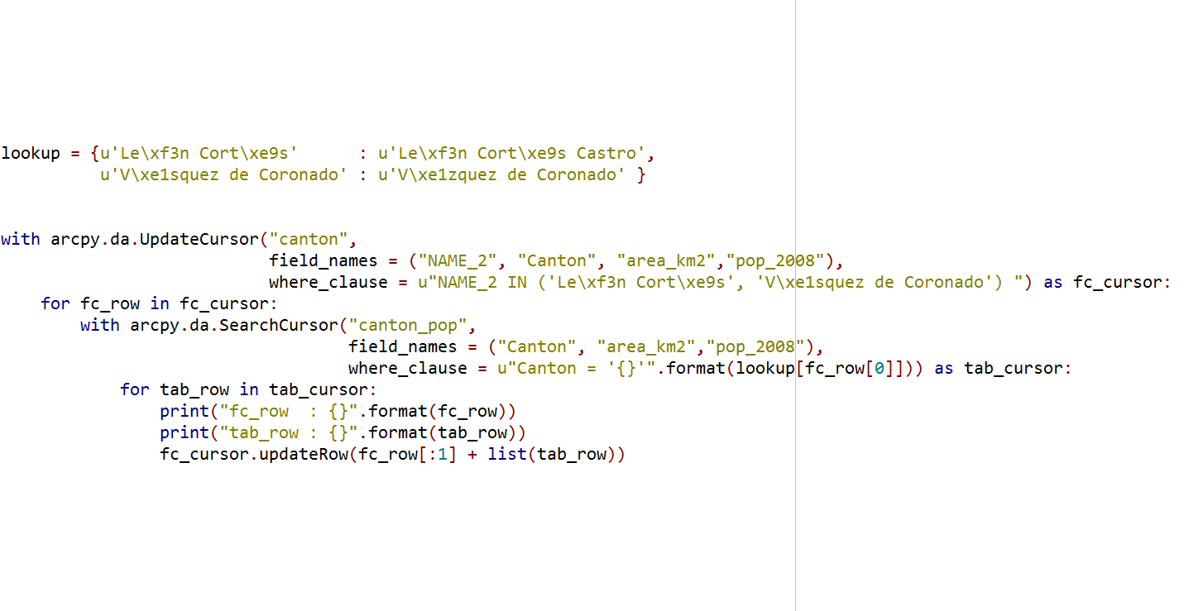
Cursors
esriurl.com/10618

Slide 8
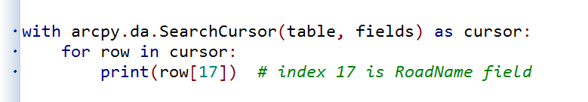
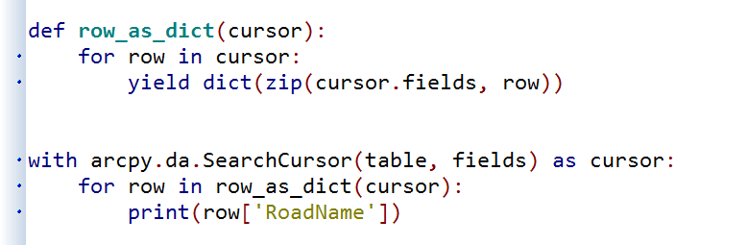
More on cursors
Row values are accessed by index
Good for performance, not as good for code readability
Alternatively, can convert to a dictionary on the fly
Wrap with a generator function
Access by name

Slide 9
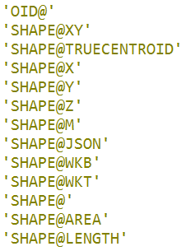
Fields and tokens
For best performance, use only those fields you need
Can use "*" for all fields if necessary
Tokens can be also be used
Get only what you need (accessing full geometry is more expensive)
Equivalent to using the geometry field name

Slide 10
Editor class
Uses edit sessions and edit operations to manage transactions
Edits are temporary until saved and permanently applied
Can quit an edit session without saving changes
When do you need to use?
To edit feature classes that participate in a…
Topology
Geometric network
Versioned datasets in enterprise geodatabases
Some objects and feature classes with class extensions

Slide 11
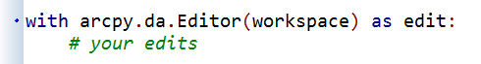
Editor using a with statement
Editor supports with statements
Handle appropriate start, stop and abort calls for you
Open an edit session and start an edit operation
Exception—operation is cancelled,
edit session is closed without
saving
No exceptions—stop the operation
and save and close the edit
session

Slide 12
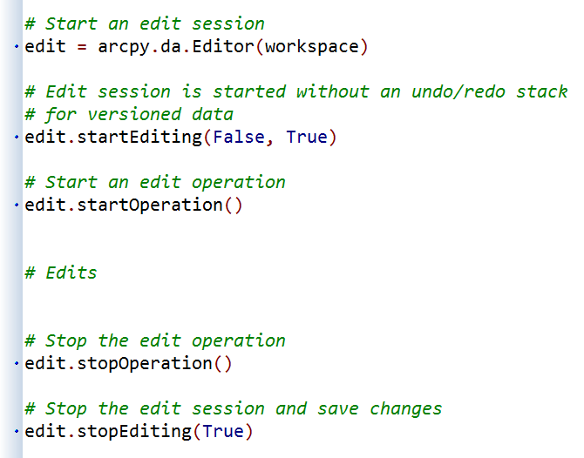
Editor class
Editor class also includes methods for working with edit sessions and operations
Editor methods
startEditing ({with_undo}, {multiuser_mode}) | Starts an edit session.
stopEditing(save_changes) | Stops an edit session.
startOperation() | Starts an edit operation.
stopOperation() | Stops an edit operation.
abortOperation() | Aborts an edit operation.
undoOperation() | Undo an edit operation (roll back modifications).
redoOperation() | Redoes an edit operation.

Slide 13
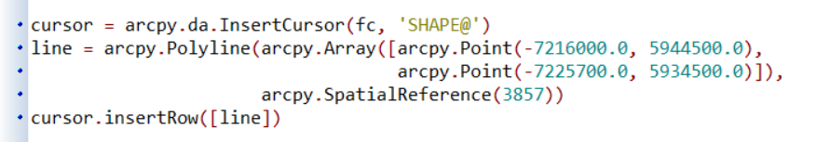
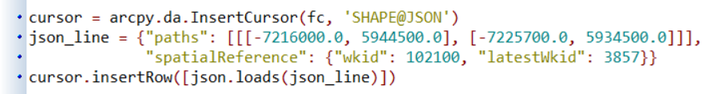
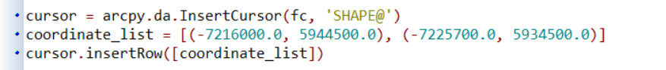
Working with geometry
Creating geometry objects can be a bit unwieldly
Many different options for accessing/creating geometry within a cursor
Geometry objects
Esri JSON
List of coordinates
dumps

Slide 14
Iterating over data
Many processes require cataloging or iterating over data
Common theme are arcpy list functions
30+ across arcpy and modules
arcpy.da list functions:
ListDomains | Lists the attribute domains belonging to a geodatabase
ListFieldConflictFilters | Lists the fields in a versioned feature class that have field conflict filters applied
ListReplicas | Lists the replicas in a workspace
ListSubtypes | Return a dictionary of the subtypes for a table or feature class
ListVersions | List the versions in a workspace
Notes:
]

Slide 15
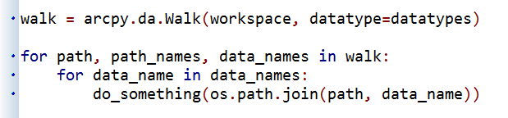
Walk
Traverse a directory structure to find ArcGIS data types
Returns a tuple of three: path, path names, and filenames
Similar pattern to Python’s os.walk
Comparison:
Walk: http://esriurl.com/5931
The hard way: http://esriurl.com/5932

Slide 16
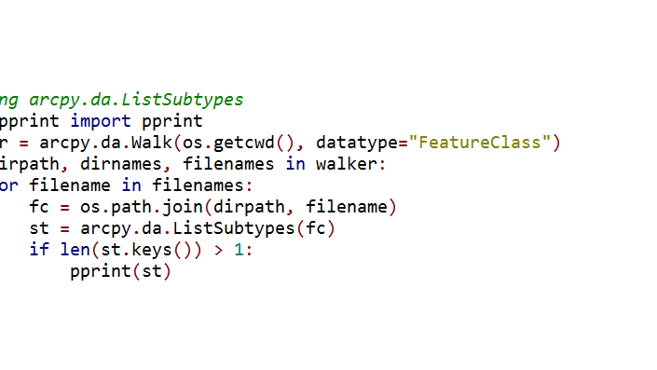
Iterating over data
esriurl.com/10618

Slide 17
NumPy
NumPy is a 3rd party Python library for scientific computing
A powerful array object
Sophisticated analysis capabilities
arcpy.da supports converting tables and feature classes to/from numpy arrays
FeatureClassToNumPyArray, TableToNumPyArray
Can also converting rasters to/from numpy arrays
RasterToNumPyArray, NumPyArrayToRaster
(found in main arcpy namespace)

Slide 18
NumPy functions
arcpy.da provides additional support for tables and feature classes
Function
FeatureClassToNumPyArray | Convert a feature class to an array
TableToNumPyArray | Convert a table to an array
NumPyArrayToFeatureClass | Convert an array to a Feature Class
NumPyArrayToTable | Convert an array to a Table
ExtendTable | Join an array to a Table

Slide 19
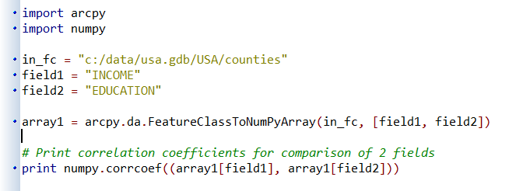
Export to NumPy
Can convert tables and feature classes into numpy arrays for further analysis

Slide 20
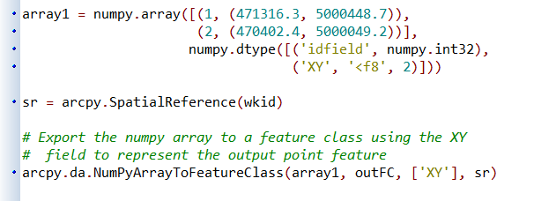
Import from NumPy
Take the product of your work in numpy and export it back to ArcGIS
Points only
Polygons, lines, multipoints?
http://esriurl.com/5862

Slide 21
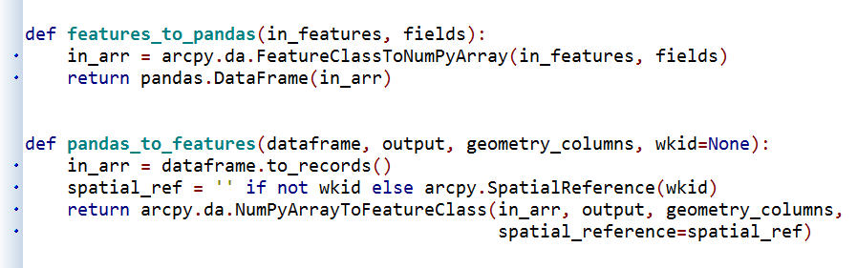
pandas
pandas is 3rd party library known for high-performance, easy-to-use data structures and analysis tools
Added to ArcMap, Server, Engine at 10.4
Added to ArcGIS Pro 1.1*
pandas was part of the our now obsolete external Python at 1.0

Slide 22
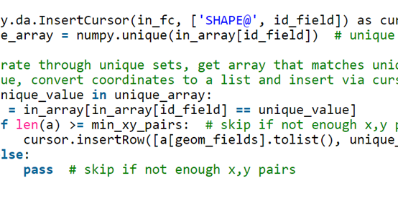
arcpy, numpy and pandas
esriurl.com/10618

Slide 23
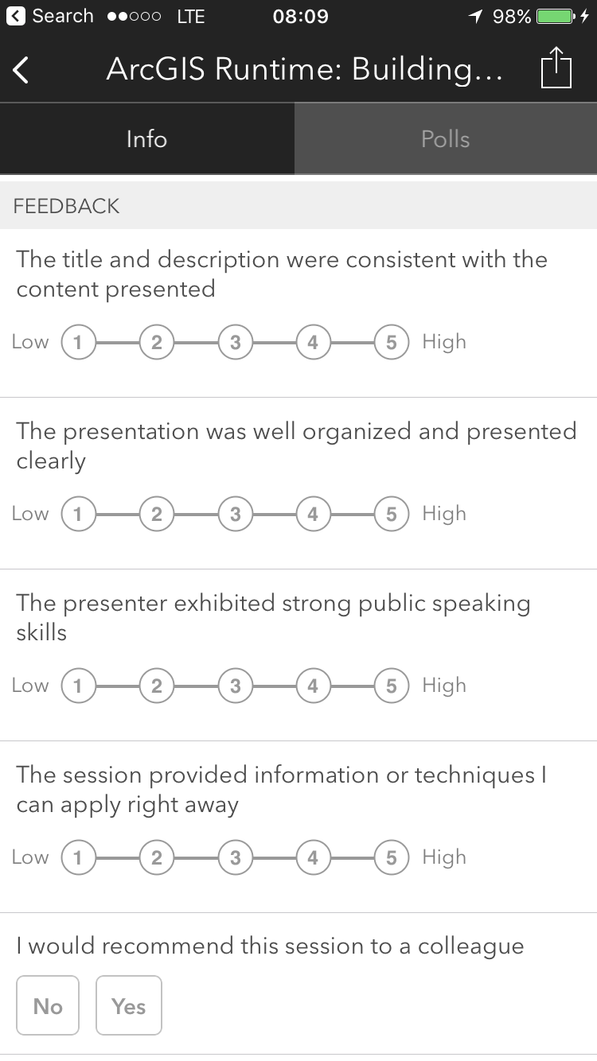



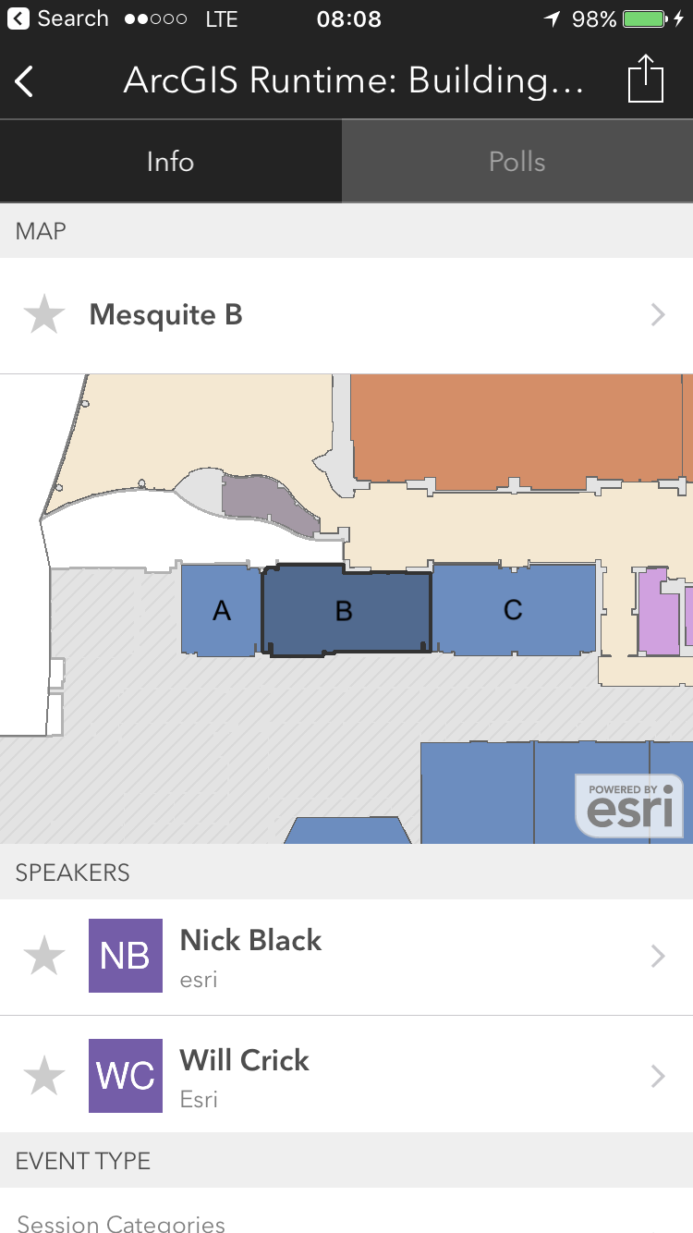
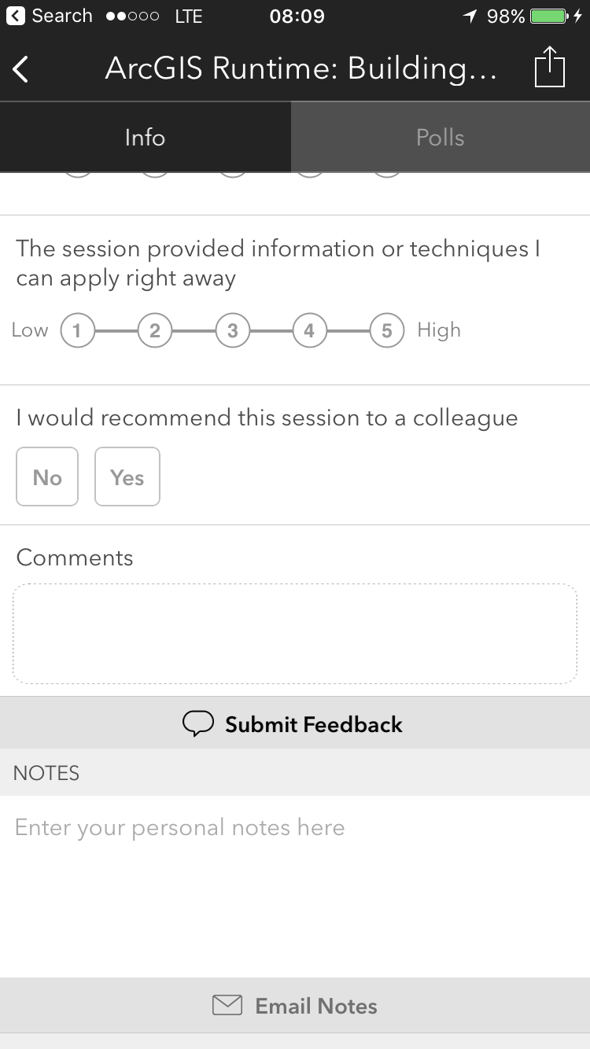
Please Take Our Survey!
Download the Esri Events app
and find your event
Select the session you
attended
Scroll down to the
“Feedback” section
Complete Answers,
add a Comment,
and Select “Submit”

Slide 24



